Slide 1
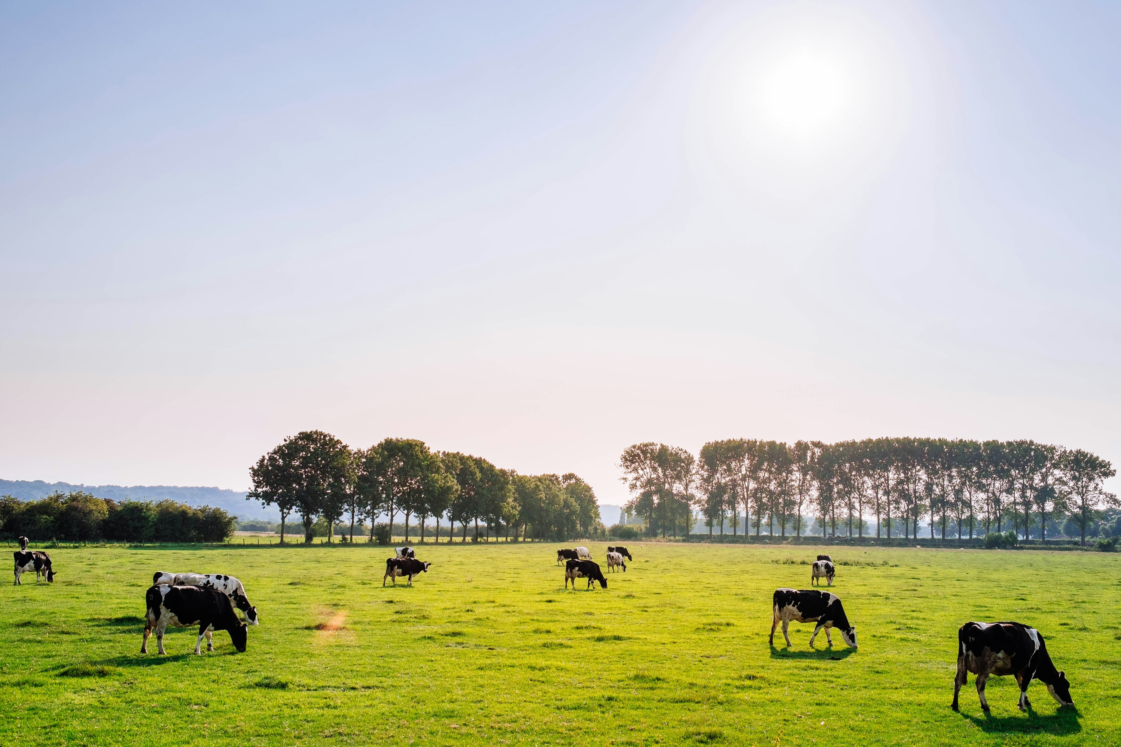
DAIRY
CARE
SYSTEM
Comprehensive Dairy Management
Krishnendu Lal
S3 Regular MCA
2023 - 2025

Slide 2
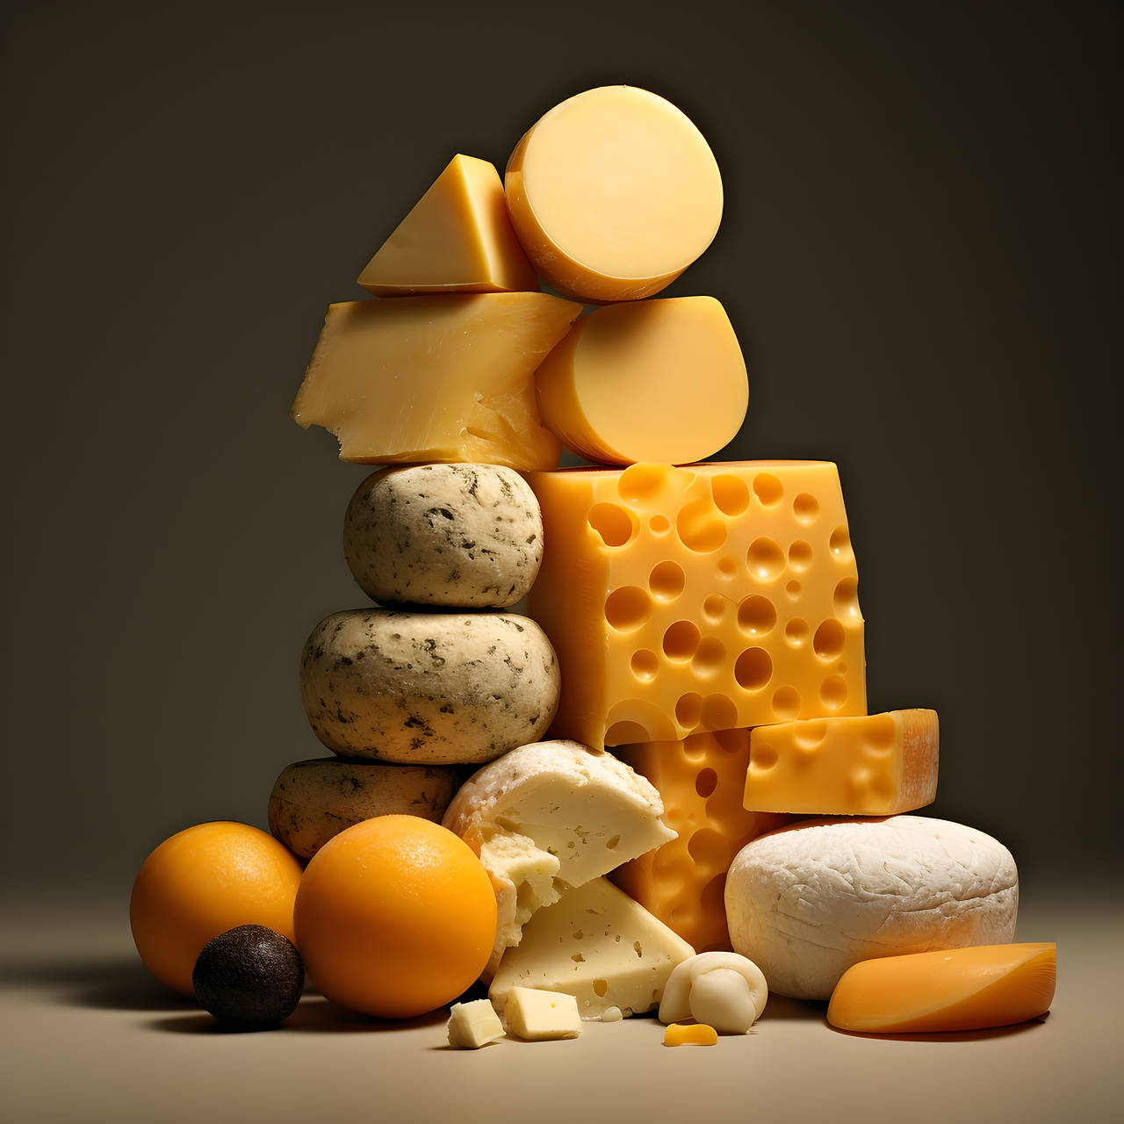
Introduction
Objective: A comprehensive web application designed to enhance the efficiency, productivity, and profitability of dairy farms. Developed using Django, the Dairy Care System enables farmers to streamline livestock management, milk production tracking, and health records, providing an all-encompassing platform for dairy farm operations.
Overview: This system facilitates user-friendly management across multiple roles, from administrators to customers, allowing complete oversight and interaction within dairy operations - covering sales, product inventory, farm monitoring, and customer feedback.

Slide 3
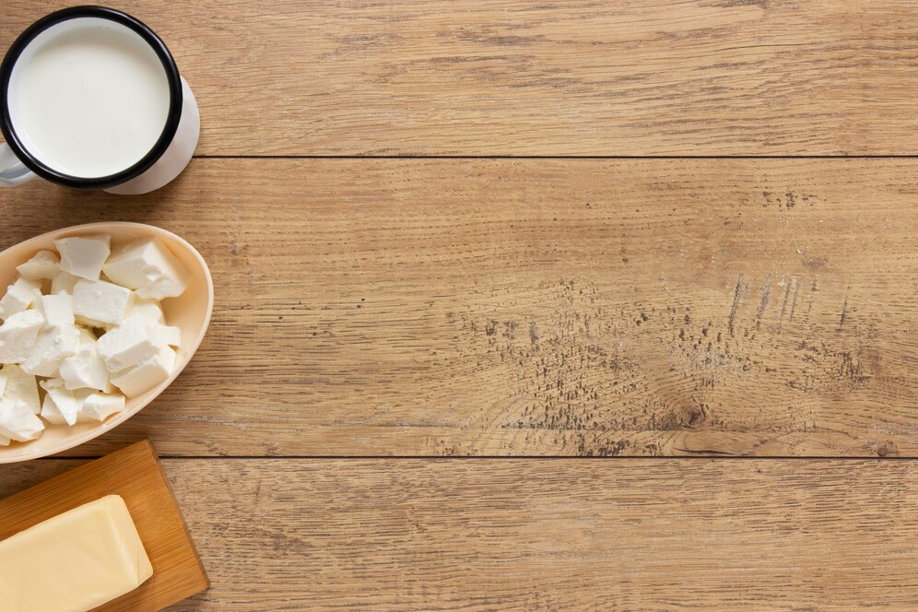
Users
Admin (Owner):
Role: Oversee entire farm operations, manage employee tasks, monitor animal health, handle sales and feedback.
Access: Full access to all features, including permissions management and inventory control.
Employee:
Role: Conduct farm-specific tasks like managing livestock management and monitoring livestock health.
Access: Access to assigned tasks by the admin.
Customer:
Role: Browse products, make purchases, submit feedback.
Access: Register, manage profile, purchase and pre-purchase products and provide feedback.

Slide 4
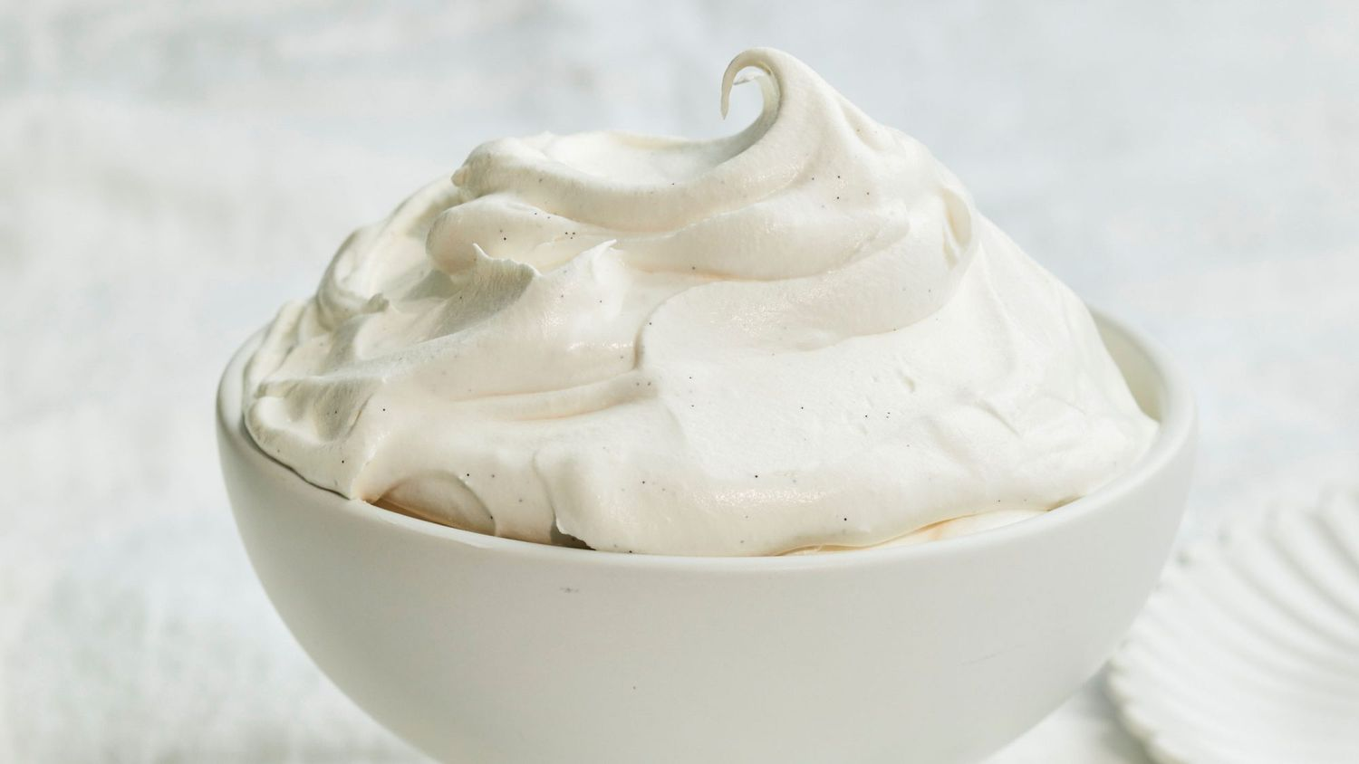
Functionalities
User Authentication & Management:
Secure login and registration for all roles.
Admin permissions to manage user roles and oversee account security.
Product & Inventory Management:
Product Search & Purchase: Customers can search, buy products online via Razor-Pay or cash on delivery.
Product Management: Owners can add, update, and track dairy product inventory.
Farm Monitoring:
Feeding Details Collection: Record and manage animal feeding schedules and nutritional data.
Health Monitoring: Monitor milk production, animal health, and assign treatments as prescribed by doctors.
Payment Processing:
Customer Payment: Process online transactions via Razor-Pay or handle cash on delivery.
Feedback & Analysis:
Feedback Submission: Customers submit feedback on products and services.
Feedback Analysis: Admin analyzes customer feedback to improve operations.

Slide 5

Technologies
Frontend: HTML, CSS, JavaScript for a responsive and interactive interface
Backend: Django (Python-based framework) for handling logic, database management, and authentication
Database: MySQL for storing user, product, order, and farm data securely
Operating System: Windows (for development environment)
IDE: Visual Studio Code

Slide 6

Future Scope
Non-Dairy Product Expansion:
Expand product offerings to include non-dairy alternatives for a broader customer base.
Advanced Analytics:
Integrate machine learning for data-driven insights on animal health, milk yield predictions, and optimized
feeding schedules.
Mobile Application Development:
Create a mobile app to allow customers and farm managers on-the-go access to purchasing, order
management, and farm monitoring features.
IoT Integration:
Implement IoT sensors for real-time tracking of milk yield, animal health, and environmental conditions
within the farm.
Automated Inventory Reordering:
Auto-generate orders for critical inventory items based on threshold levels.
Expanded Payment Gateways:
Integrate additional payment options for customers.

Slide 7
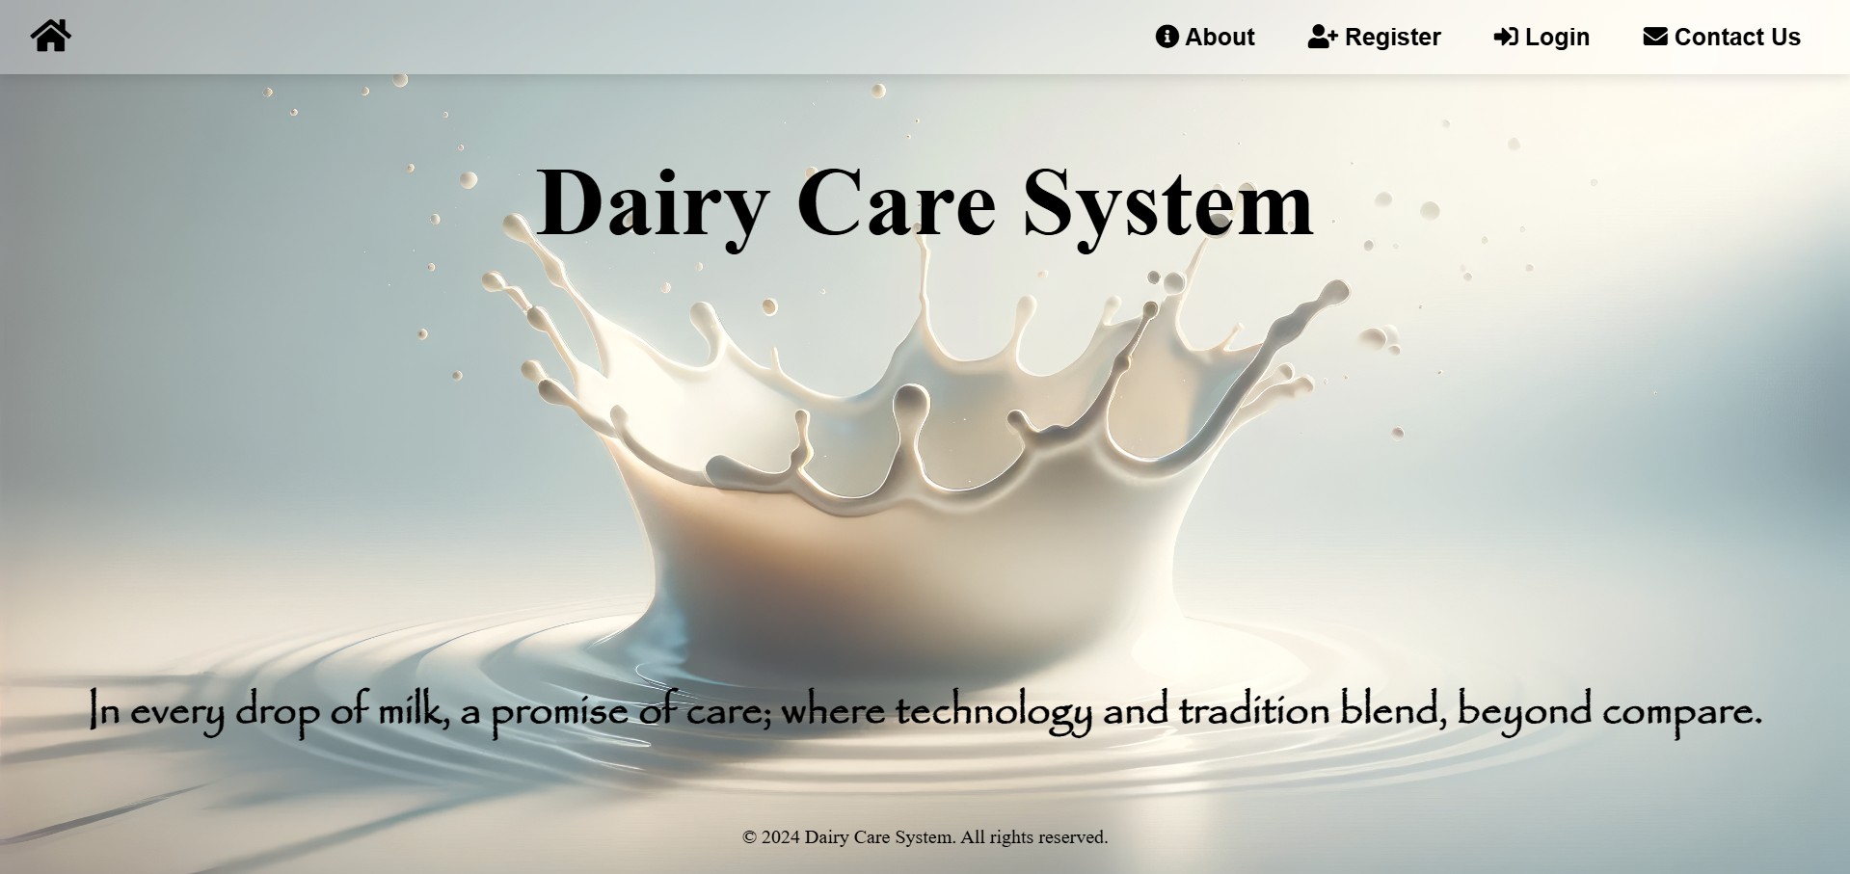
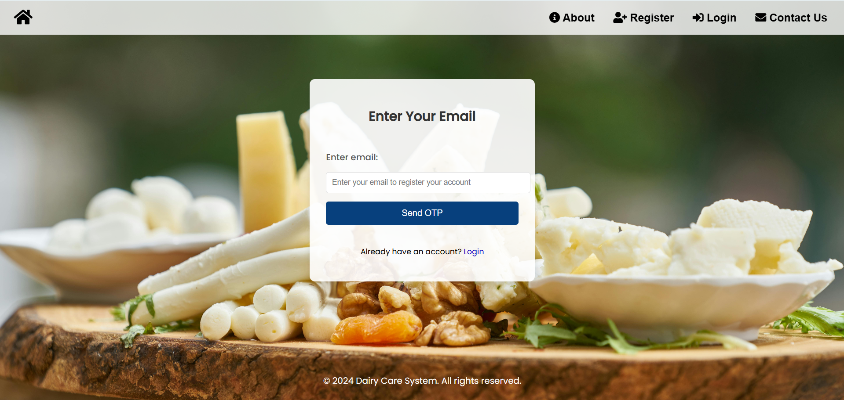
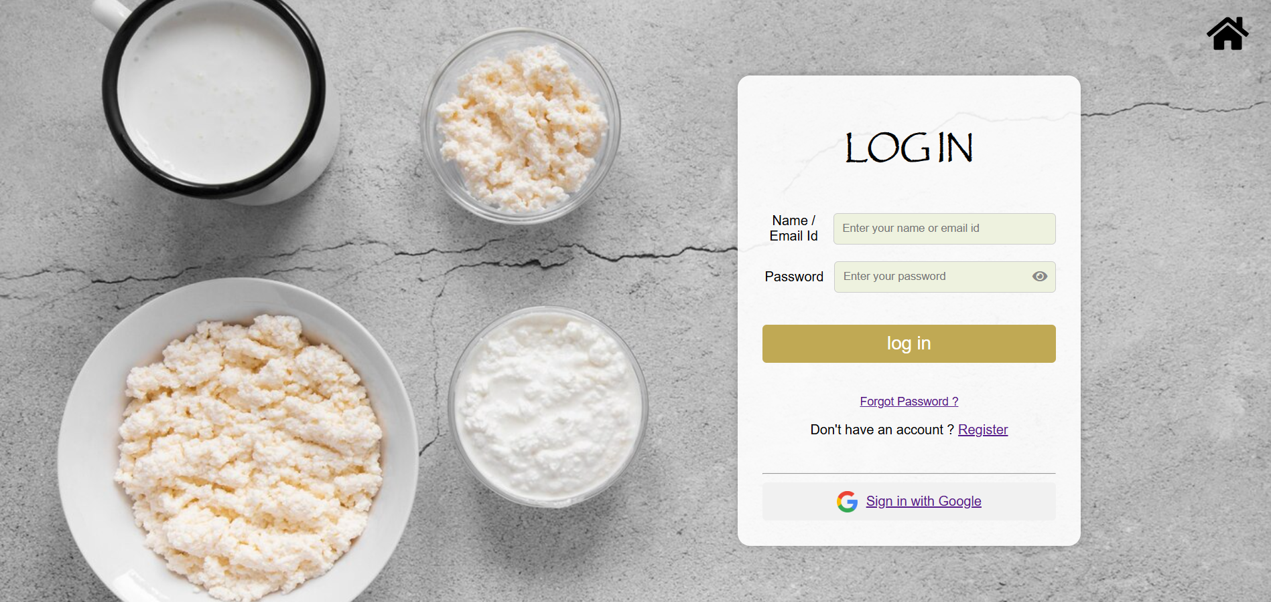

Slide 8
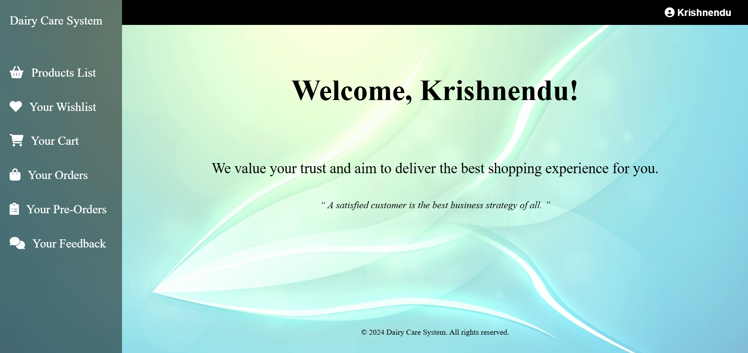
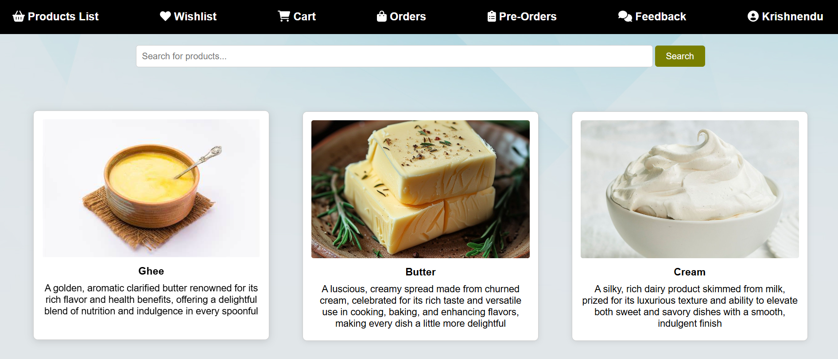
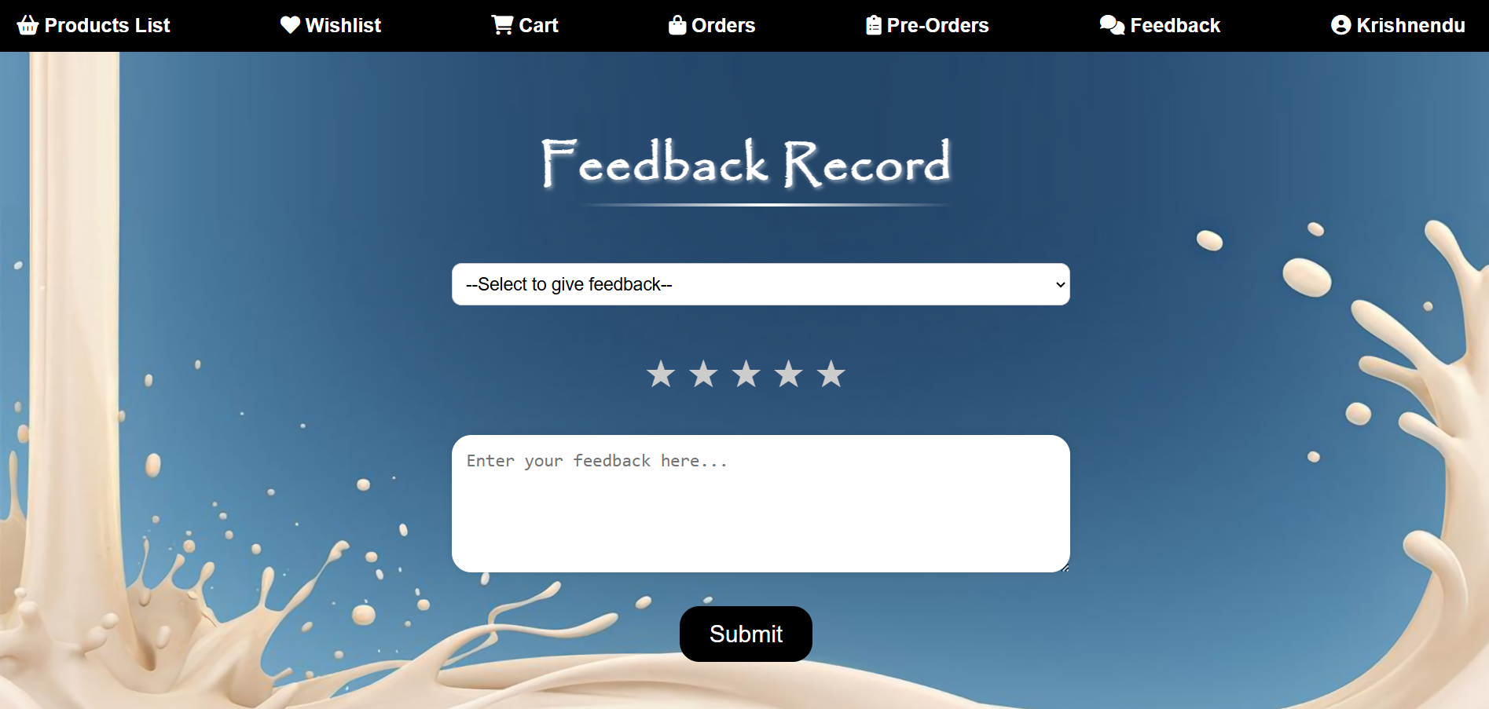
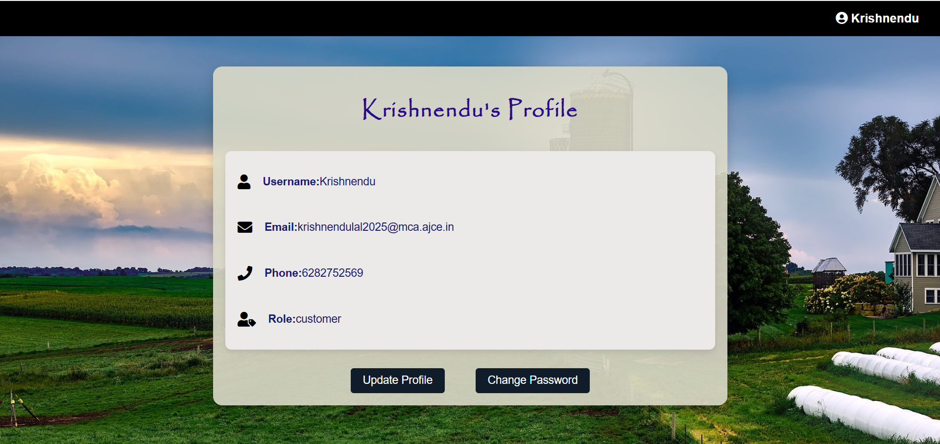

Slide 9
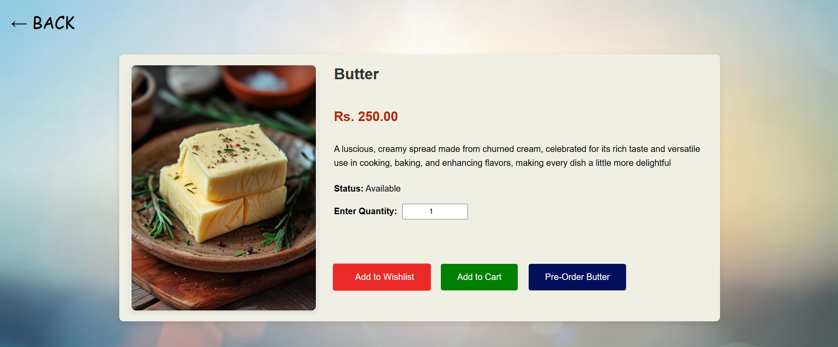
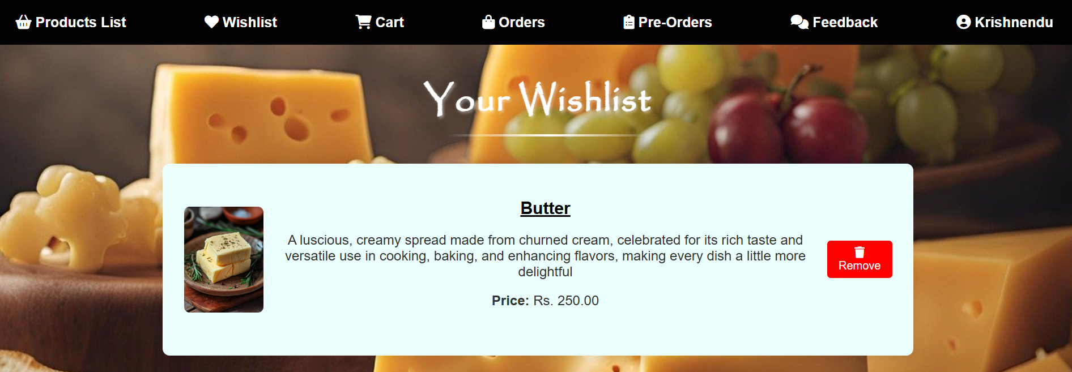
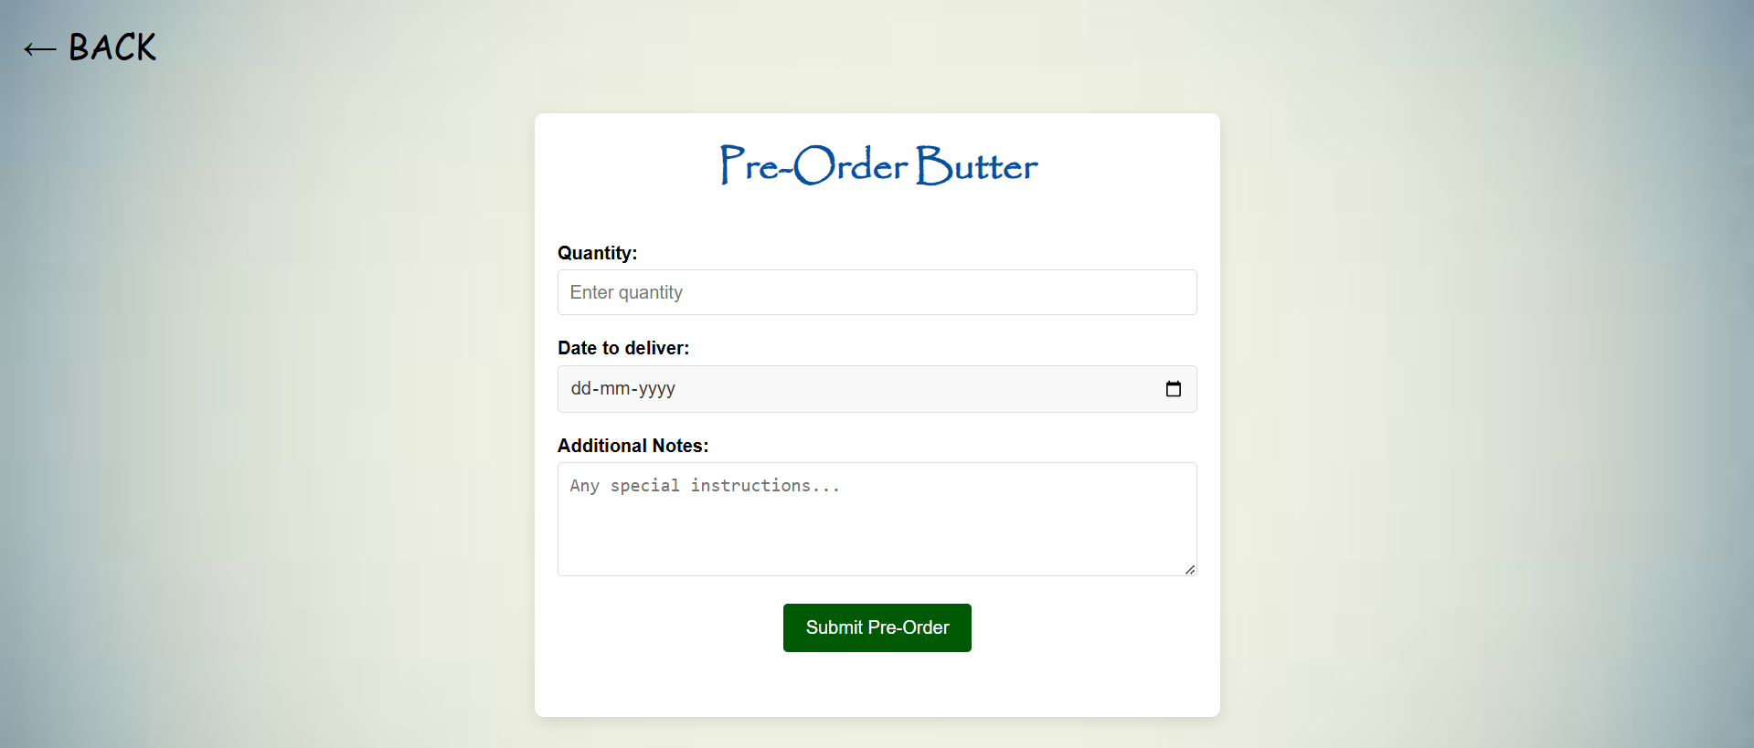
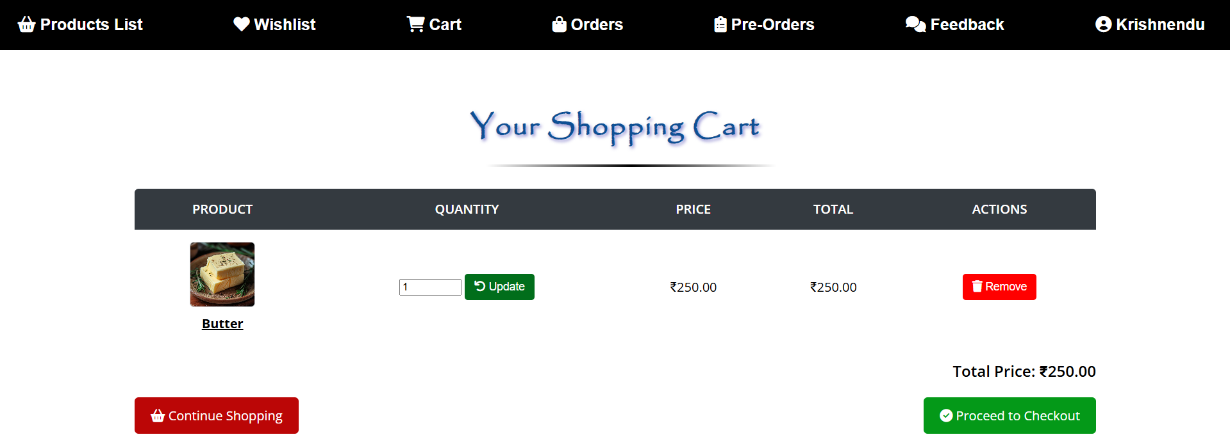

Slide 10
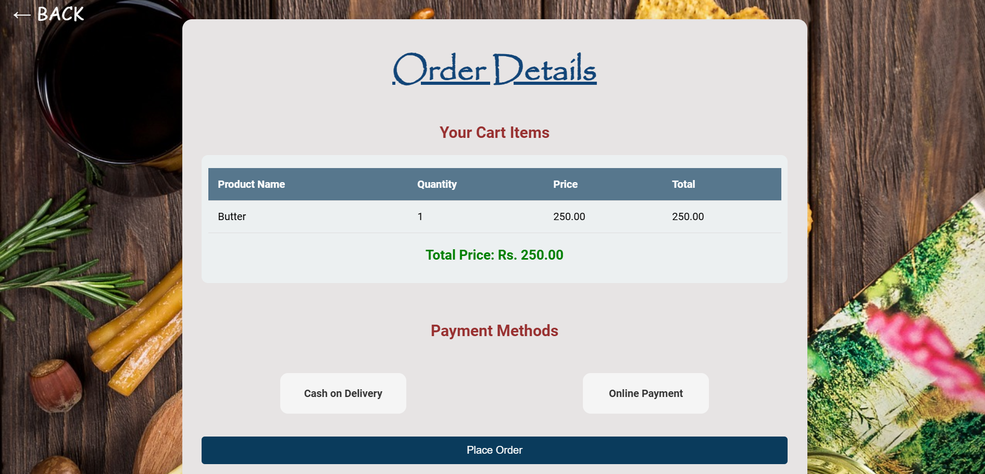
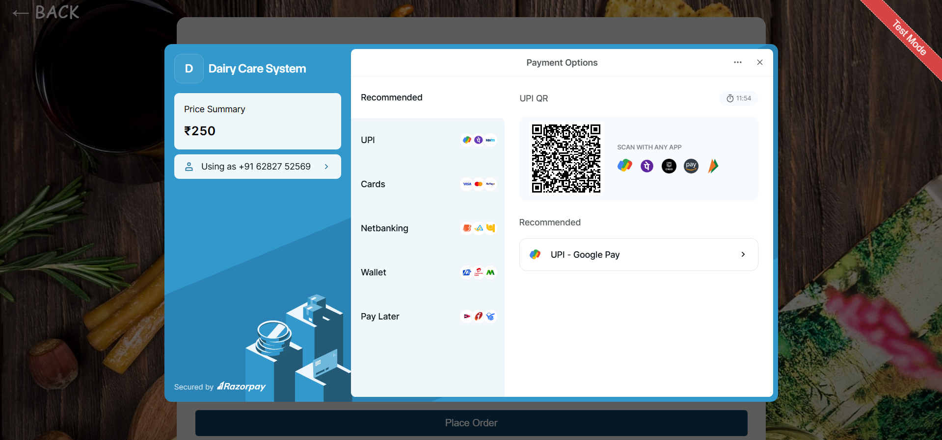
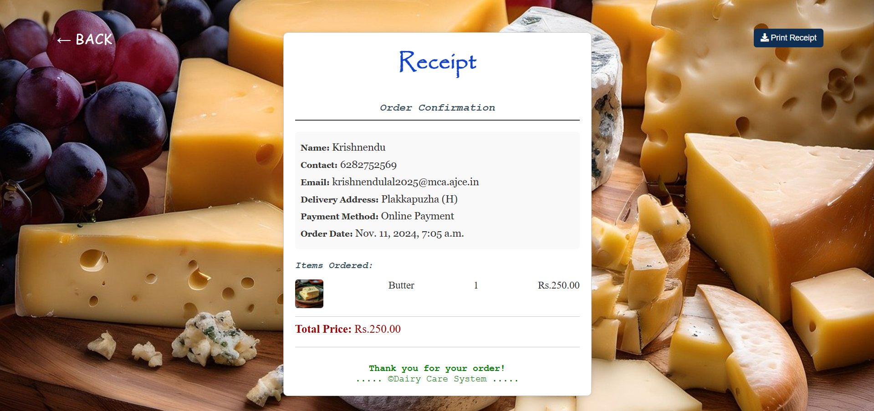
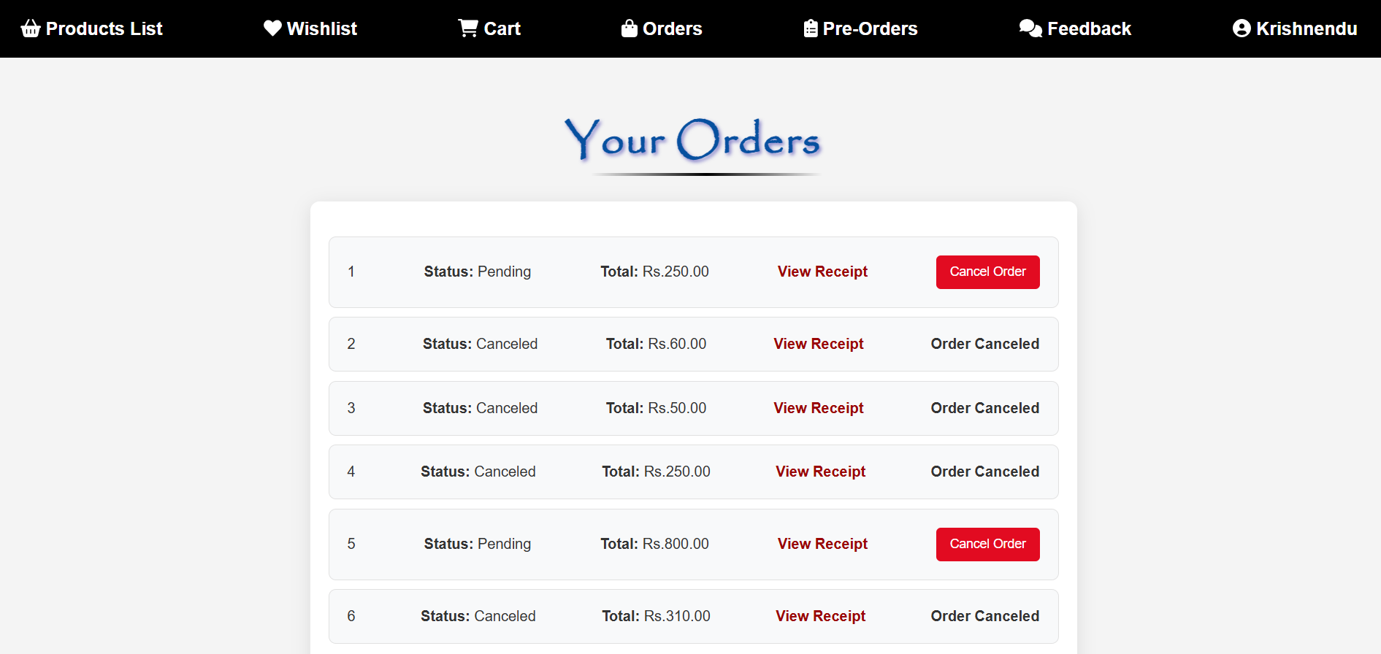
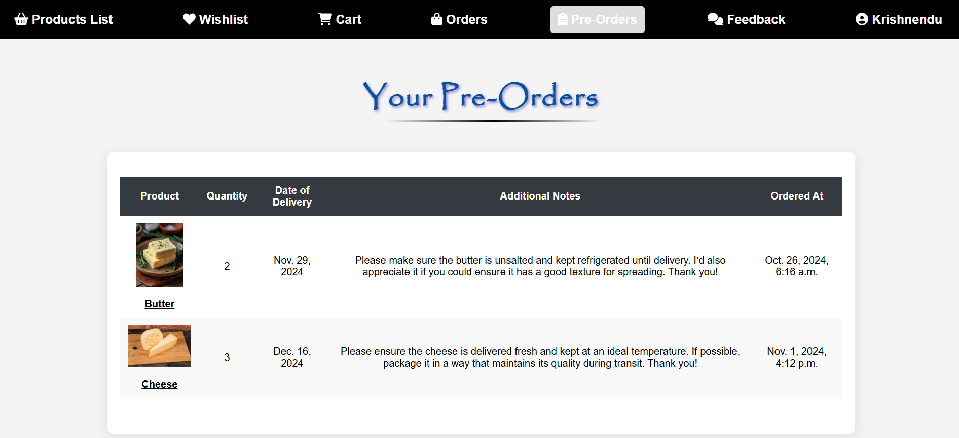

Slide 11
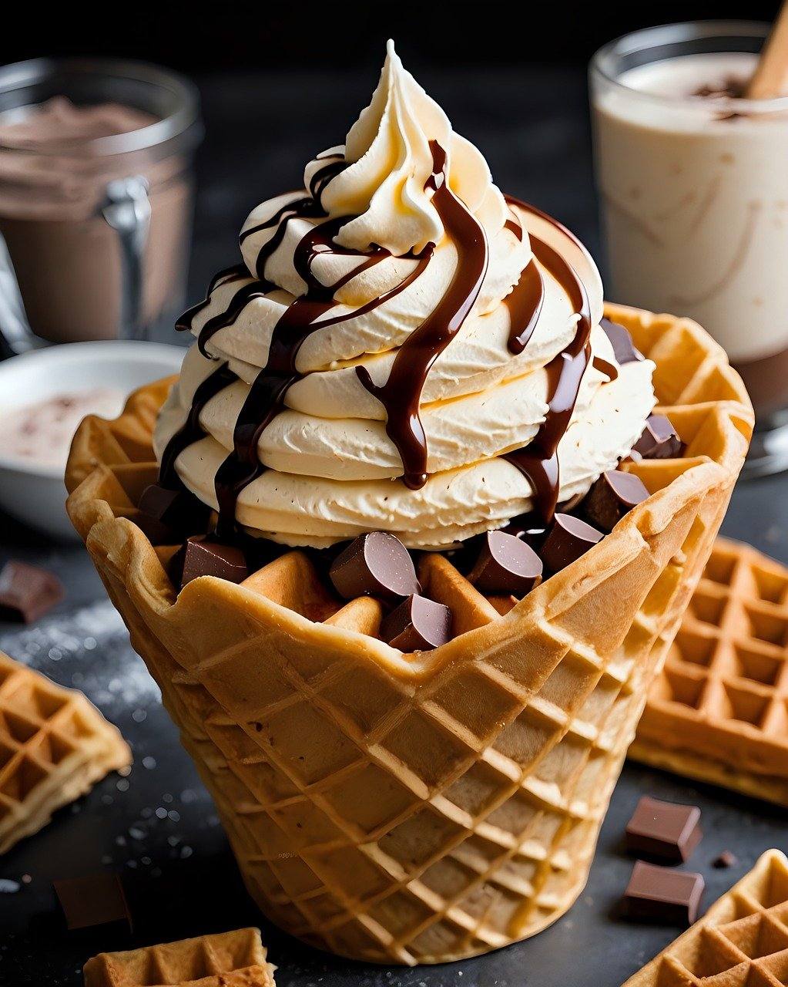
Conclusion
The Dairy Care System serves as a versatile, efficient platform for managing dairy farm operations, improving productivity, and also transparency, and customer satisfaction.
Empowers farm owners to optimize workflows, ensures the well-being of livestock, enhances sales management, and strengthens the customer relationship through streamlined farm management.

Slide 12
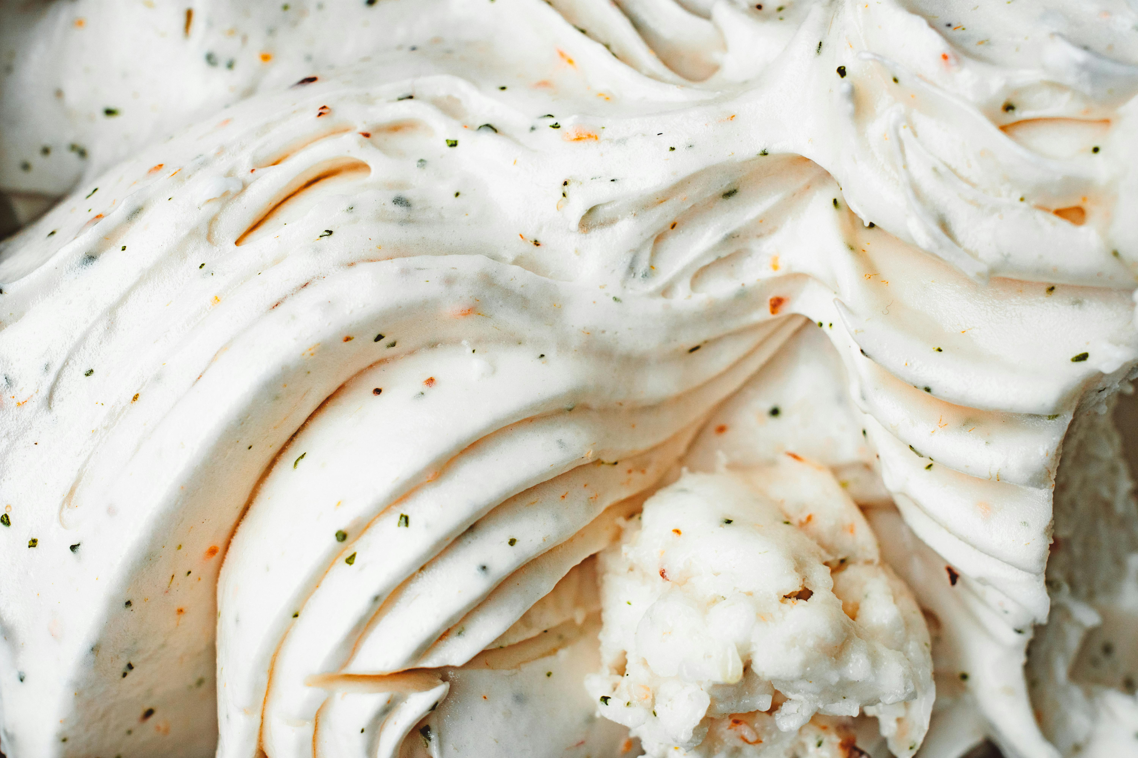
THANK
YOU
By,
Krishnendu Lal
S3 Regular MCA
2023 - 2025
To,
Amal K Jose
Assistant Professor
Amal Jyothi College of Engineering (Autonomous),
Kanjirappally, Kottayam

